Slide 1

EE746 Neuromorphic Engineering Lecture 2.1: Biological Neuron
Udayan Ganguly
udayan@ee.iitb.ac.in
Aug, 10, 2023
Lectures follow Purves Chapter 1-2; Please read;
Also HW 1 is posted.
HW will take time; please do not work at the last moment.

Slide 2
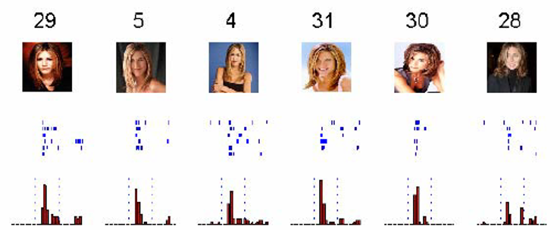
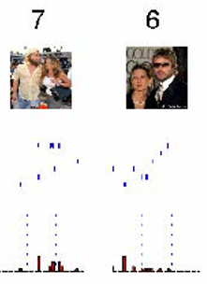
Invariant representation: Whole
How much information is needed about a subject? Is the same subject stored in different places in the brain?
Neurons in human medial temporal lobe (MTL) fire for faces
Nature Vol 435, 23 June 2005
doi:10.1038/nature03687
“I know it is Jennifer Aniston, and it does not matter how you present her to me, whether in a red dress, in proﬁle, as a written name or even when you call her name out loud.
How do we connect
structure to function to behavior?
Blocks to unit to system?
Notes:
Abstract: It takes a fraction of a second to recognize a person or an object even when seen under strikingly different conditions. How such a robust, high-level representation is achieved by neurons in the human brain is still unclear1–6. In monkeys, neurons in the upper stages of the ventral visual pathway respond to complex images such as faces and objects and show some degree of invariance to metric properties such as the stimulus size, position and viewing angle2,4,7–12. We have previously shown that neurons in the human medial temporal lobe (MTL) fire selectively to images of faces, animals, objects or scenes13,14.
Here we report on a remarkable subset of MTL neurons that are selectively activated by strikingly different pictures of given individuals, landmarks or objects and in some cases even by letter strings with their names. These results suggest an invariant, sparse and explicit code, which might be important in the transformation of complex visual percepts into long-term and more abstract memories.
“For example, in one case, a unit responded only to three completely different images of the ex-president Bill Clinton. Another unit (from a different patient) responded only to images of The Beatles, another one to cartoons from The Simpson's television series and another one to pictures of the basketball player Michael Jordan. This suggested that neurons might encode an abstract representation of an individual. ”
Figure 1a shows the responses of a single unit in the left posterior hippocampus to a selection of 30 out of the 87 pictures presented to the patient. None of the other pictures elicited a statistically significant response. This unit fired to all pictures of the actress Jennifer Aniston alone, but not (or only very weakly) to other famous and non-famous faces, landmarks, animals or objects. Interestingly, the unit did not respond to pictures of Jennifer Aniston together with the actor Brad Pitt (but see Supplementary Fig. 2). Pictures of Jennifer Aniston elicited an average of 4.85 spikes (s.d. ¼ 3.59) between 300 and 600 ms after stimulus onset. Notably, this unit was nearly silent during baseline (average of 0.02 spikes in a 700-ms pre-stimulus time window) and during the presentation of most other pictures (Fig. 1b). Figure 1b plots the median number of spikes (across trials) in the 300–1,000-ms post-stimulus interval for all 87 pictures shown to the patient. The histogram shows a marked differential response to pictures of Jennifer Aniston (red bars).

Slide 3
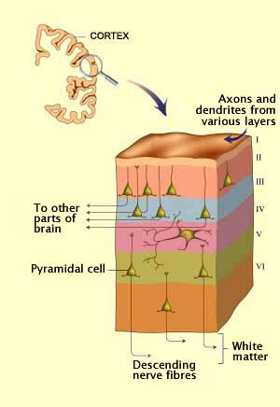
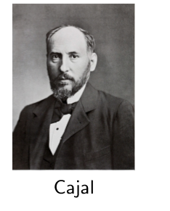
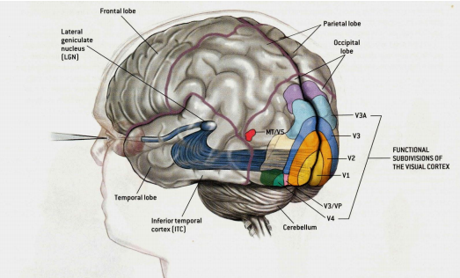
Cerebral Cortex
Cerebral cortex in human brain is 6 layers, 2-4 mm thick
Feedforward and feedback connection between hierarchical layers
Brain builds invariant representations of stimulus through spikes
Initially it was difficult to see the nerve cells and their connections
Notes:
This shows structure of the brain with layers present in it. Each layer has different composition of neurons. This dense intertwined arrangement makes probing of individual neuron difficult and therefore extracting information about single neuron is a non trivial task.

Slide 4
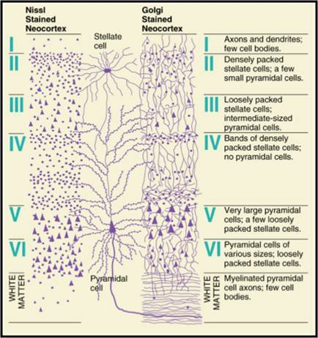
6 layers of the brain after staining
Stella = star
e.g. stellar performance;
Inter-stellar travel
Individual cells could not be “observed” because of geometric complexity
Reticular theory:
Each nerve cell was connected to its neighbors by protoplasmic links, forming a continuous nerve cell network, or reticulum. – Camillo Golgi.
Golgi pioneered light microscopic examination of nervous tissue stained with silver salts
Notes:
This shows the composition of each of the layers in the brain. Golgi hypothesized a continuous network structure.

Slide 5
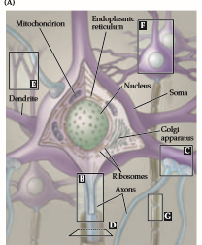
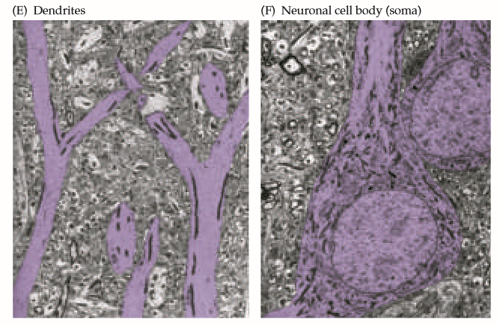
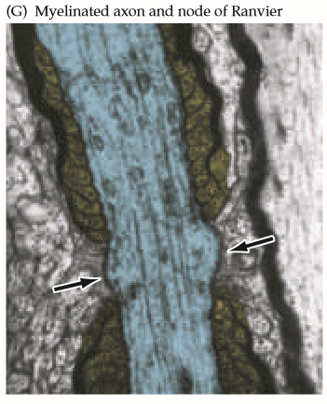
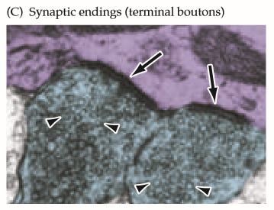
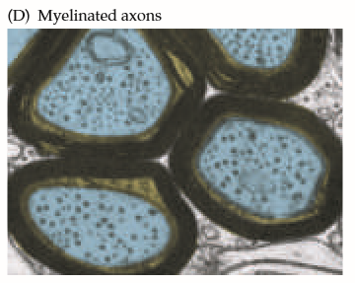
Cajal vs.(and) Golgi
Neuronal Doctrine:
Cajal : Nerve cells are discrete entities, and that they communicate with one another by means of specialized contacts that Sherrington called “synapses.”
Nobel Prize for Physiology or Medicine in 1906 to both Golgi and Cajal
Notes:
Cajal also stated the same fact calling the connections as synapses

Slide 6
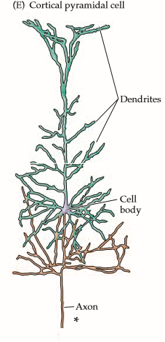
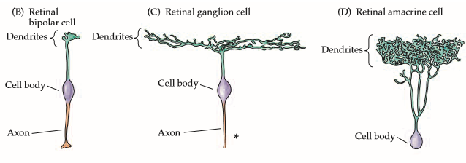
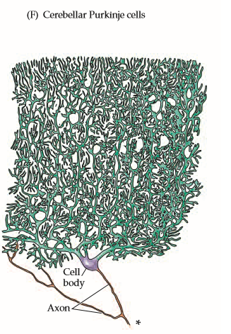
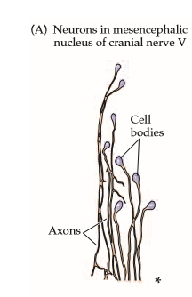
Neuronal Cells
No axon
short axon
Nerve cell are of various types; shapes and sizes and are axons are like a pile of noodles; they are difficult to track without staining.
Notes:
Different type of neuronal cells with differing number of dendrites, lengths and shapes are found in the body. These are specialized for certain tasks. Understanding tasks and functions each of them are responsible for to reverse engineer the brain structure is the next big question in neuroscience.

Slide 7
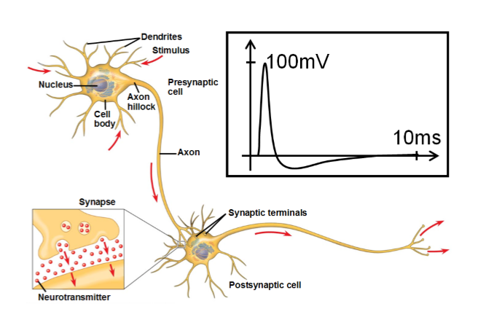
Essential Neuronal System
Soma - cell body (4µm to 100µm in diameter)
Axon - Output terminal (1µm-1mm in diameter)
Dendrite - Input terminal
Knowing the structure – can we understand its function? And then understand behavior
Notes:
Neurons communicate via synapses. The dendrites take the input current, process it and pass it on to the next neuron.

Slide 8
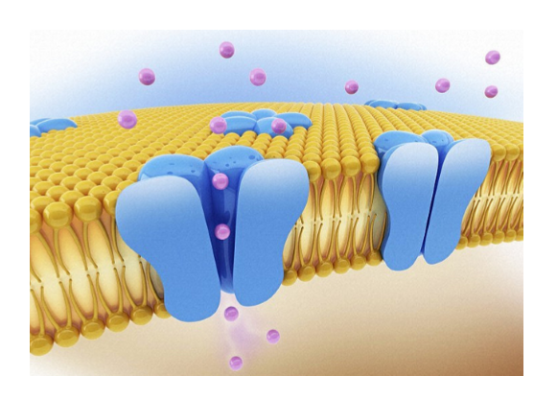
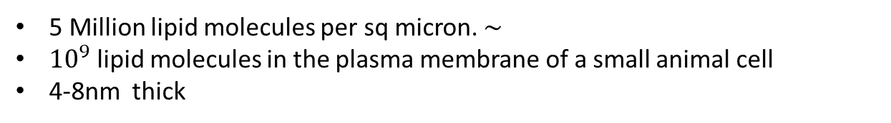
Cell Membrane
Membrane is decorated with proteins that operate as channels and pumps
5 Million lipid molecules per sq micron. ∼
${10}^{9}$ lipid molecules in the plasma membrane of a small animal cell
4-8nm thick
Notes:
Membrane of neuron cells has channels allowing particular ions to pass through. There are both chemical and voltage gated channels present in neurons.

Slide 9
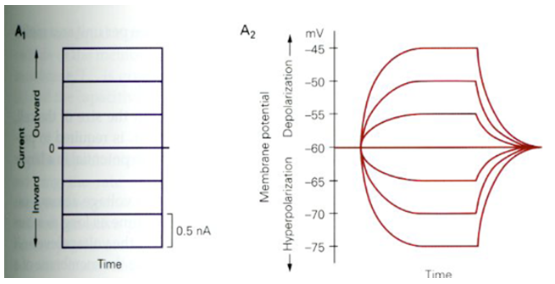
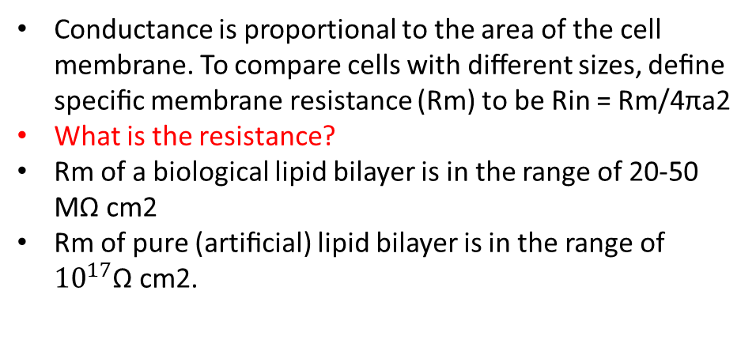
Cell Membrane Resistance
Conductance is proportional to the area of the cell membrane. To compare cells with diﬀerent sizes, deﬁne speciﬁc membrane resistance (Rm) to be Rin = Rm/4πa2
What is the resistance?
Rm of a biological lipid bilayer is in the range of 20-50 MΩ cm2
Rm of pure (artiﬁcial) lipid bilayer is in the range of ${10}^{17}$Ω cm2.

Slide 10
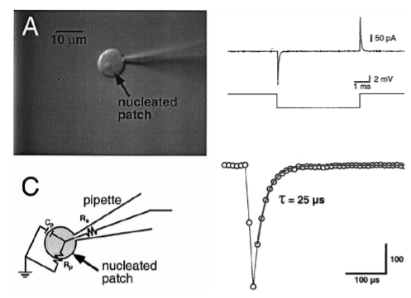
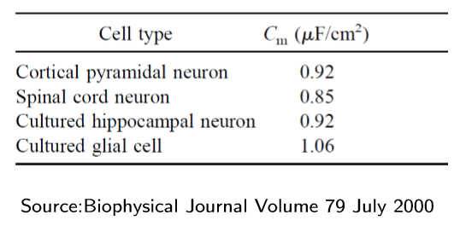
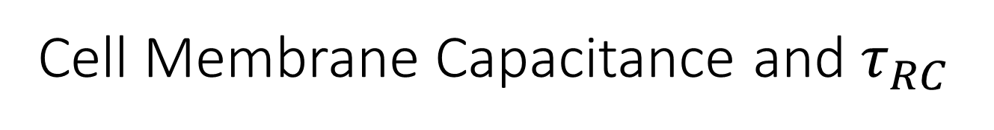
Cell Membrane Capacitance and $τ_{RC}$
Capacitance is proportional to the area of the cell membrane.
To compare cells with diﬀerent sizes, deﬁne speciﬁc membrane capacitance (Cm) to be Cm = Cin/4πa2
Cm is ∼ 1µ F/cm2
Notes:
With change in voltage across the membrane, current spike is observed to flow showing the capacitive behaviour of the channels. The values are calculated from the real experiments.

Slide 11
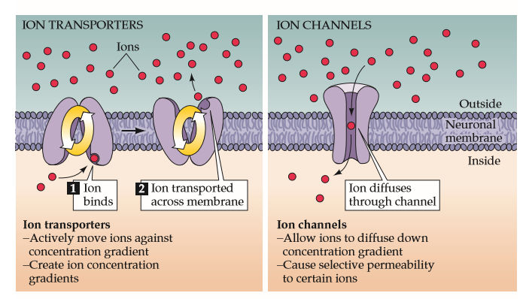

Cell Membrane
Membrane is decorated with proteins that operate as channels and pumps
$$ATP→ADP+Pumping energy$$
passive
Q 1: A water flow analog is as follows: What are the opposing forces?
Q2: Think of an electrical analogy
Notes:
The ion activated channels are shown in the figure. The ion passing is 2 step process in the first while simple diffusion takes place in the second. The channels opening requires energy provided by ATP molecules.

Slide 12
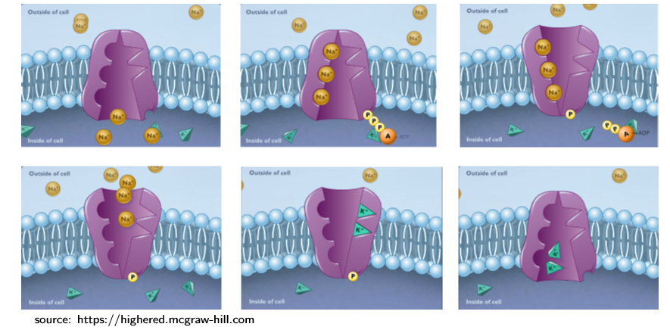
Ion pumps maintain gradient
100 ions/sec against concentration gradient
Transports 3 Na+ ions out of the cell
Transports 2 K+ ions into the cell
Costs one ATP molecule
Notes:
The schematic shown how potential gradient is maintained across the channel. Every time the channel opens the quantity of ions transported is unequal. Every passage costs one ATP molecule (energy)

Slide 13
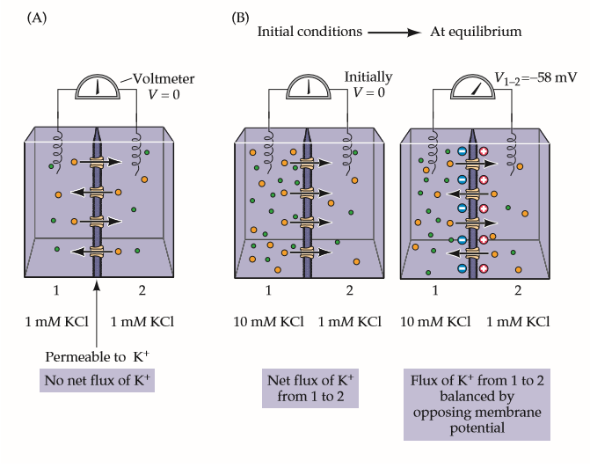
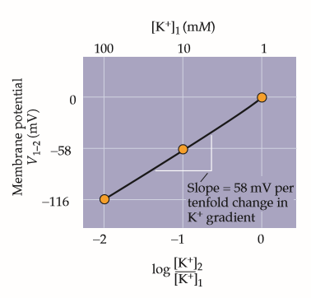
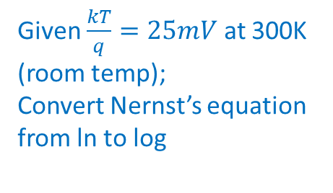


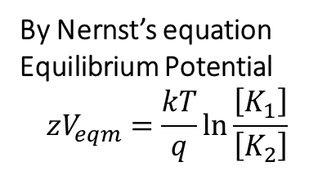
Potential Across the membrane due to ionic concentration difference
By Nernst’s equation Equilibrium Potential
$$zV_{eqm}=\frac{kT}{q}\ln{\frac{\left[K_{1}\right]}{\left[K_{2}\right]}}$$
t=$0$
t=$∞$
Given $\frac{kT}{q}=25mV$ at 300K (room temp);
Convert Nernst’s equation from ln to log
No charge imbalance
Same concentration produces dynamic equilibrium but no concentration change
Slight charge imbalance = large potential
Where are the charges located (a) across membrane or (b) diffuse?
Different concentration produces dynamic equilibrium opposed by charge imbalance
Notes:
q n mu [x] E=D d[X]/dx
q n mu dV/dx = D {d ln([X]) /dx}
Using Einstein’s equation: D/mu=kT/q
Integrating x
qnV=kT * ln[X]
N (V1-V2)=kT/q * ln [X1]/[X2]

Slide 14
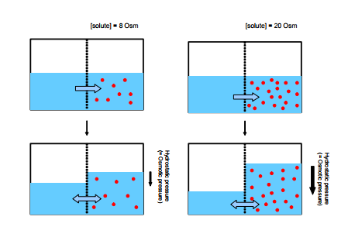

Analogy: Osmosis
t=0
t=$∞$
Question: What are the opposing forces and flow?
What happens when membrane is impermeable at t>0?
What about last slide case?

Slide 15
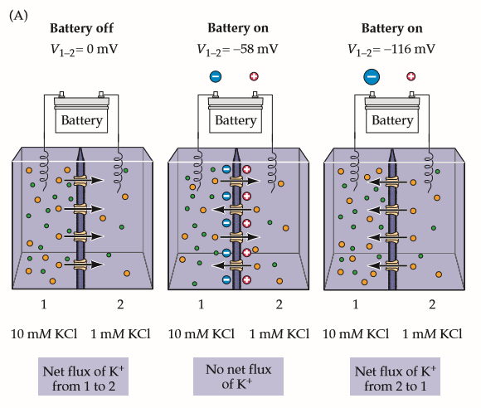
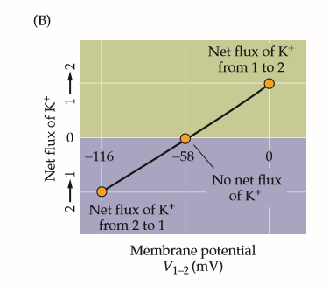

Ionic Concentration difference due to applied bias
Ionic flow current is given by
$$J = zµ[X] \vec{E} −D\frac{∂\left[X\right]}{∂x }$$
Potential difference inside vs. outside
How is drift affected by V? How is diffusion affected by V?
What can be modulated by potential? Concentration or flux?
What about if membrane in impermeable?
Notes:
The flux of an ion is shown to be membrane potential dependent. The flux varies linearly with applied voltage. If the membrane is impermeable on the other hand the imbalance in the potential remains as it is.

Slide 16
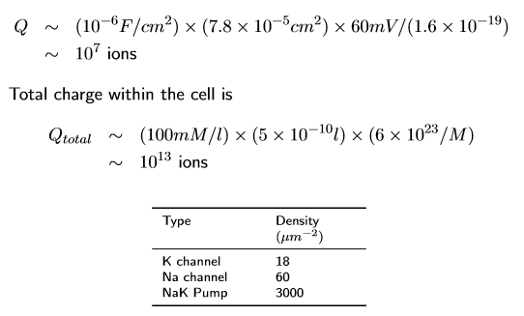
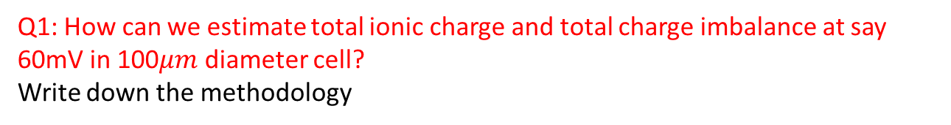
What is the extent of charge imbalance vs. total ionic charge?
Q1: How can we estimate total ionic charge and total charge imbalance at say 60mV in 100$μm$ diameter cell?
Write down the methodology
Q2: How long will it take to deplete one neuron cell?
Write down the methodology!

